Slide 1
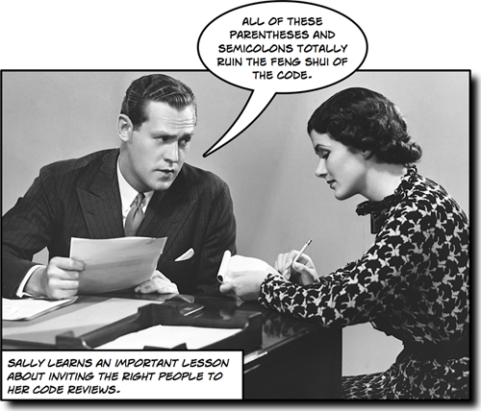
Code review
Time to discuss your code!

Slide 2
Code HW #1 – Code Review
You will be assigned to a partner, then take turns explaining the code you wrote for your homework, and discussing
Some good discussion points to consider:
Did you encounter any problems or get stuck anywhere?
Are there parts you are unhappy with (or happy with)?
What differences are there between your solutions? What are the potential pros and cons?
Are there any lines of code that are repeated or could be written more succinctly?

Slide 3
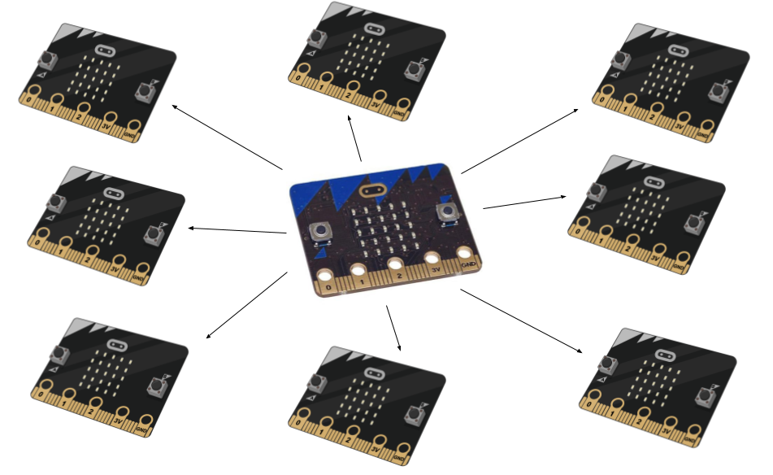
Wireless Communication

Slide 4
Using the micro:bit wirelessly
The BBC micro:bit has an onboard transceiver that is capable of both Bluetooth Low Energy and radio communications.
They use the same 2.4GHz frequency to transmit and receive
There are subtle differences in each protocol that make them more appropriate for certain tasks or activities.
Bluetooth (BLE)
Primary way in which to make your micro:bit communicate with your mobile device
Creates a secure 'trust' relationship between devices, so that you have to initially ask permission in order to send and receive data (i.e. “pair” devices)
Radio
Simple protocol that allows you to transmit and receive data from and to another device that uses the same protocol
Radio does not care for security protocols or trust relationships. It just sends information in the hope that someone receives it!

Slide 5
Radio Module
The radio module allows devices to work together via simple wireless networks.
Full documentation at https://microbit-micropython.readthedocs.io/en/latest/radio.html
import radio
from microbit import *
radio.on()
radio.config(channel=2)
while True:
if button_a.was_pressed():
radio.send('hello')
incoming = radio.receive()
if incoming == 'hello':
display.show(Image.HAPPY, delay=100, wait=False)

Slide 6
Radio Functions
radio.on()
radio.off()
radio.config(**kwargs)
radio.reset()
radio.send_bytes(message)
radio.receive_bytes()
radio.receive_bytes_into(buffer)
radio.send(message)
radio.receive()
radio.receive_full()
Full documentation at https://microbit-micropython.readthedocs.io/en/latest/radio.html

Slide 7
Radio Exercises
Exercise 1 –
Find a partner with a M:B, program one M:B to receive any messages sent and print them out. Leave this M:B plugged in to the computer
Pick a CHANNEL for the two of you to send data on, e.g.:
radio.config(channel=11)
Program the second M:B to send accelerometer readings. Plug this M:B in to the battery pack. Test how far away you can receive messages!
Useful code examples in the tutorial available here -> https://microbit-challenges.readthedocs.io/en/latest/tutorials/radio.html

Slide 8
Ping Pong
Exercise 2 [more difficult!] - In this project, we will use the radio on the micro:bit to send messages from one microbit to another.
You will show a square image when a message is received so that it looks like the people holding the micro:bits are playing message ping pong.
Follow the general steps here:
https://microbit-challenges.readthedocs.io/en/latest/challenges/sensors/pingpong.html

